Slide 1
Chapter#02 – Operating System Structures

Slide 2
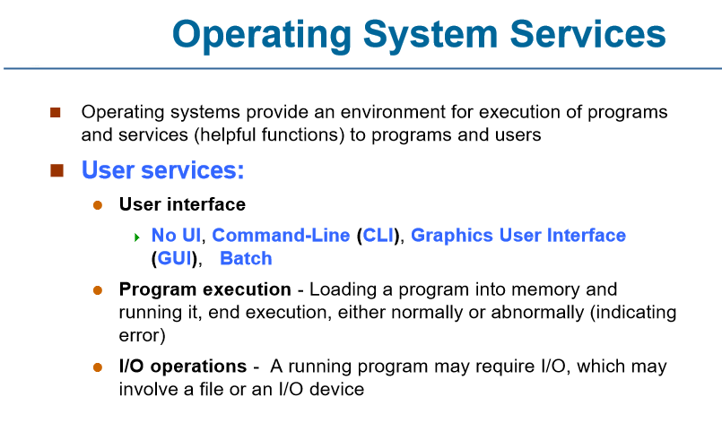

Slide 3
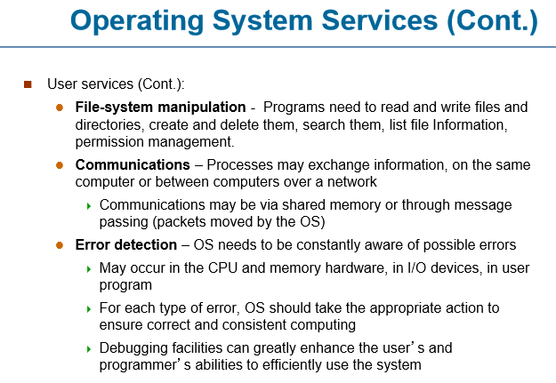

Slide 4
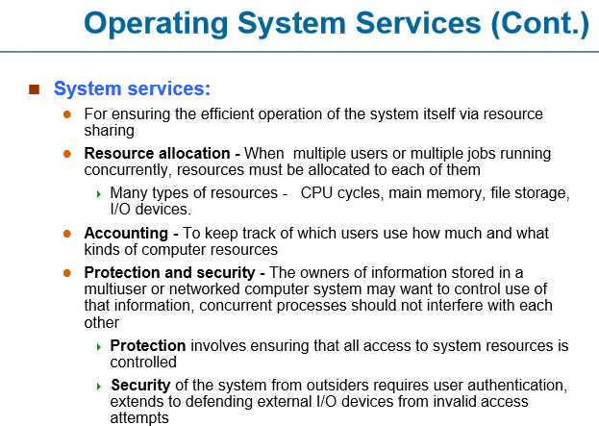

Slide 5
System Calls
Systems calls is a request made by the user program to the operating system in order to get any kind of services.
Typically written in a high-level language (C or C++)

Slide 6
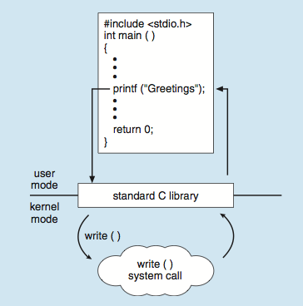
Standard C Library Example
C program invoking printf() library call, which calls write() system call

Slide 7
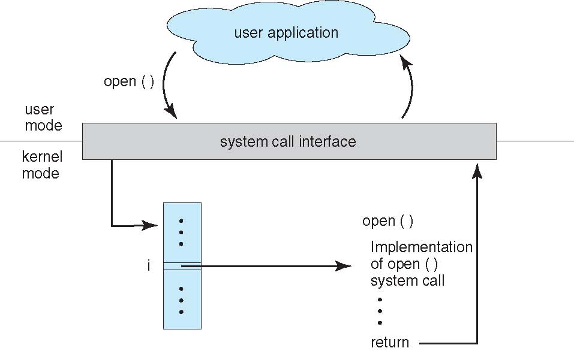
System Call – OS Relationship

Slide 8
Types of System Calls
Process control
create process, terminate process
end, abort
load, execute
wait for time
allocate and free memory
File management
create file, delete file
open, close file
read, write
Device management
request device, release device
read, write
logically attach or detach devices

Slide 9
Types of System Calls
Information maintenance
get time or date, set time or date
get system data, set system data
get and set process, file, or device attributes
Communications
create, delete communication connection
send, receive messages
transfer status information

Slide 10
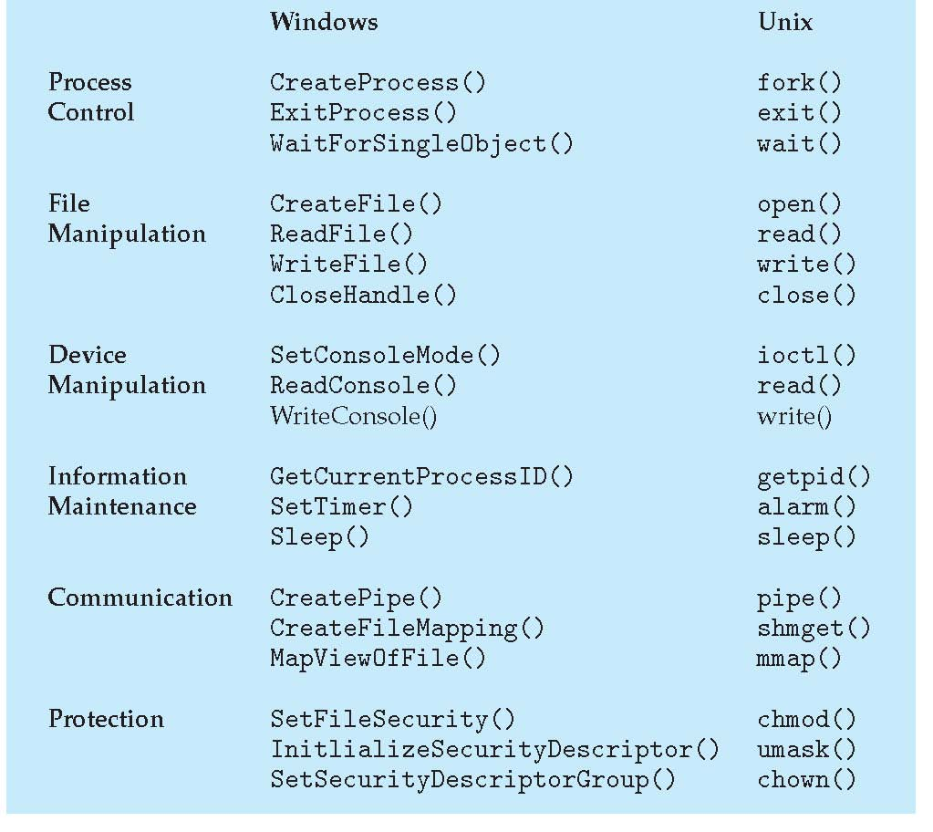
Examples of Windows and Unix System Calls

